Slide 1
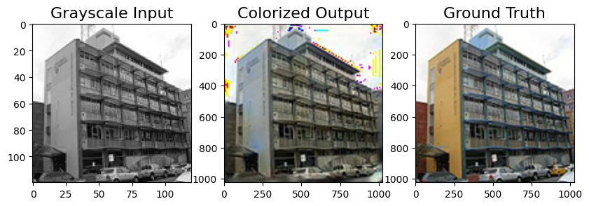
COLORIZATION OF GREYSCALE IMAGES

Slide 2
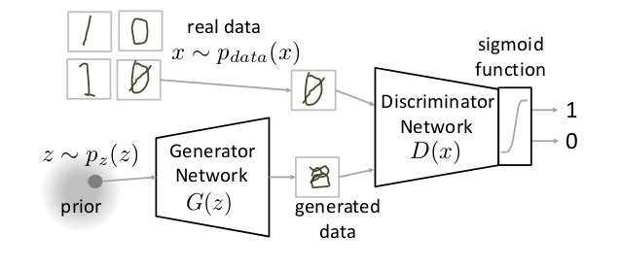
WHAT ARE GANs
Generative Adversarial Neural Network (GANs) are way to make a generative model by having two neural networks compete with each other.
The discriminator tries to identify real data from fakes created by generator
The generator turn noise into an imitation of the data to try to trick the discriminator.

Slide 3
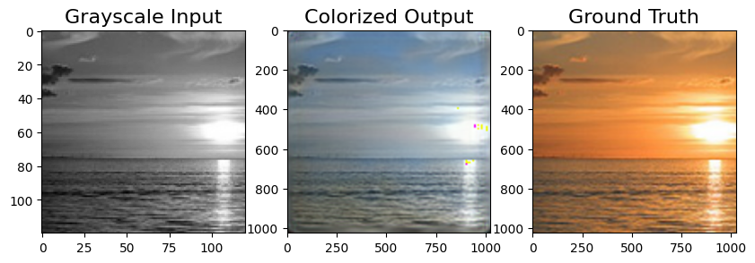
Motivation
Recolorizing and restoring old photos is a painstaking process when done manually through some photo editing software.
One solution to this problem is using GANs for restoring and recolorization of old photos.
Colorizing black and white images with deep learning has become an impressive showcase for the real world application of neural networks in out lives.

Slide 4
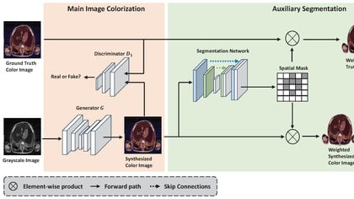
Design
GANs include two major components:
Generator
Discriminator

Slide 5
Methodology
Dataset: Our dataset will consist of 3000 RGB images from various domains (mountains, forests, cities,etc..). We will convert this RGB images to grayscale which will act as labels for our model.
For a single step , we ran the generator once and the discriminator twice.
For the discriminator, maximizing its loss would mean classifying generated images accurately as well producing a good probability (closer to 1.0) for images from the dataset.
The generator , by minimizing its loss , improves itself to such an extent that it can fool the discriminator . Fooling the discriminator means that the discriminator will produce probabilities (closer to 1.0) even for generated images.
We’ll train the discriminator in such a manner that it will output probabilities closer to 1.0 for real images (from our dataset) and output probabilities closer to 0.0 for images coming from the generator .
If the discriminator is “smart” enough, it will output the probabilities closer to 1.0 for real images(coming from our dataset). So , we are training our generator to forge such realistic images which will make the discriminator output probability closer to 1.0 even when the images are forged ( not from the dataset , but from the generator).

Slide 6
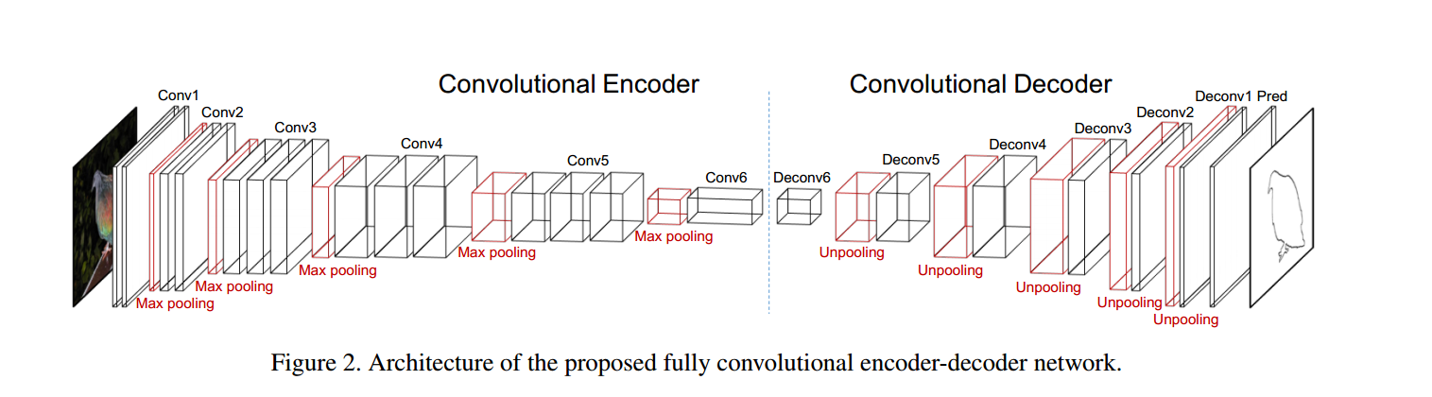
Generator
The generator will take in grayscale or B/w image, and output an RGB image. Our generator will have an encoder- decoder structure with layers placed symmetrically .
The encoder will take a grayscale images and produce a latent representation (z) of it(also called as bottleneck representation)
The decoder’s job is to produce an RGB image by enlarging this latent representation. This approach is used by most autoencoders as well as other encoder-decoder structures.

Slide 7
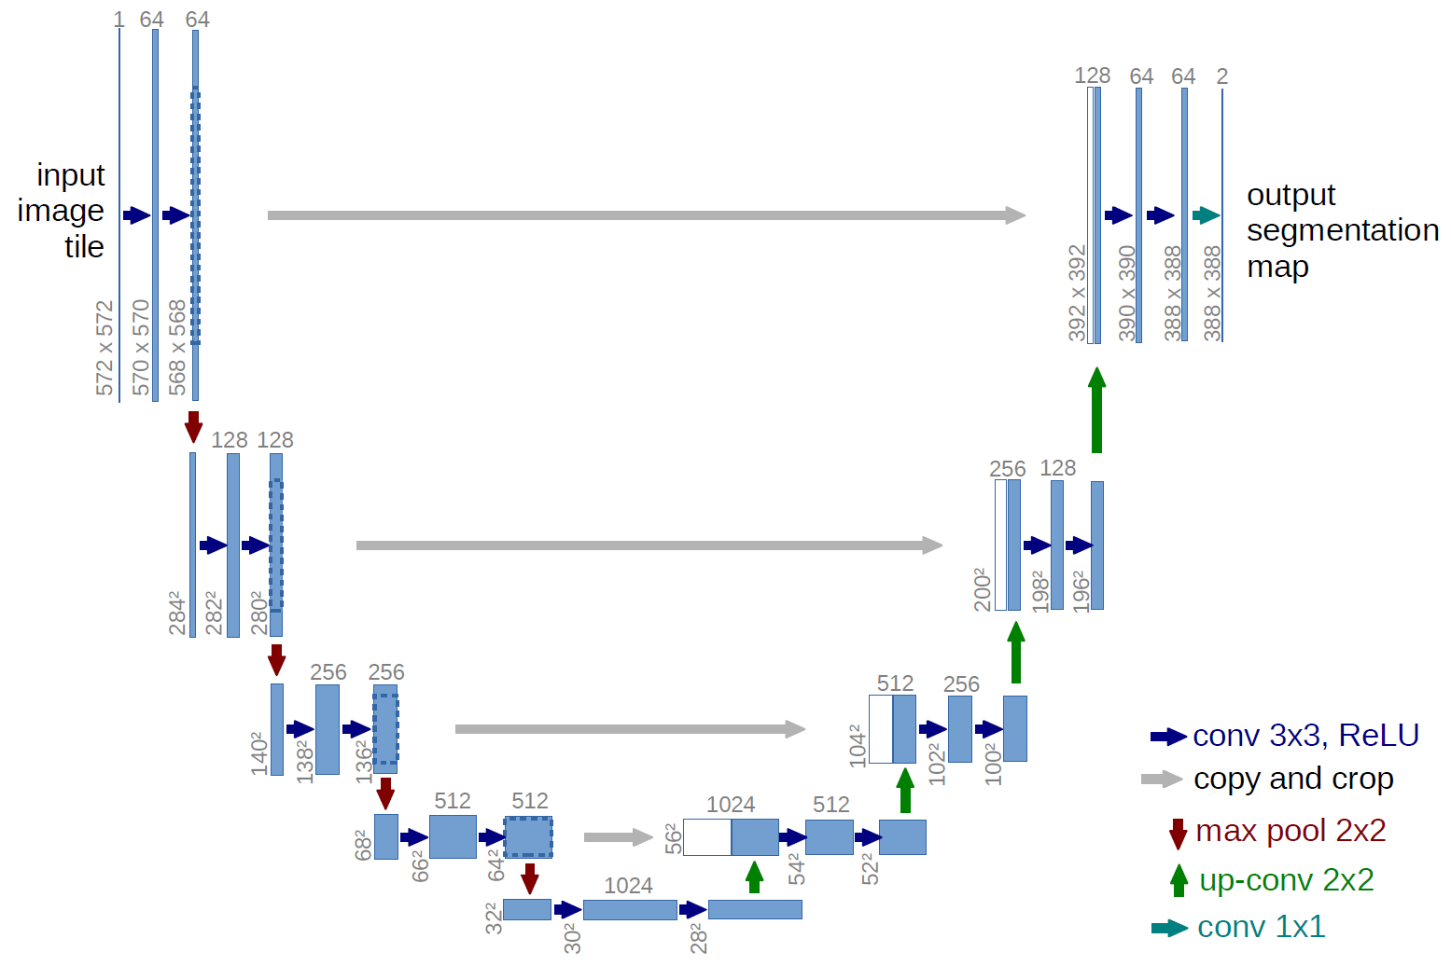
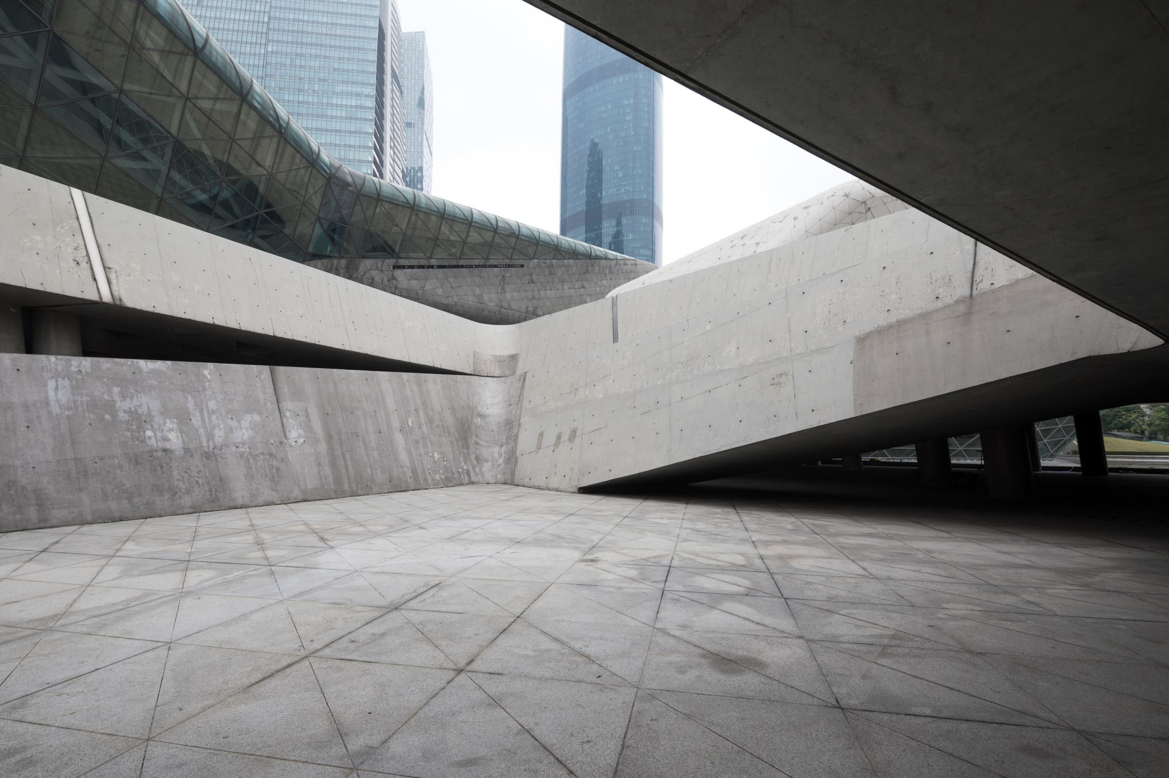
UNET Architecture
The architecture contains two paths:
First path is the contraction path (also called as the encoder) which is used to capture the context in the image. The encoder is just a traditional stack of convolutional and max pooling layers.
The second path is the symmetric expanding path ( also called as decoder) which is used to enable precise localization using transposed convolutions.

Slide 8
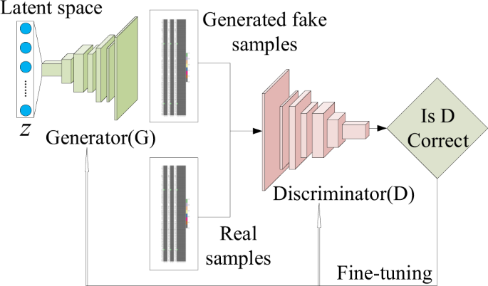
Discriminator
Our discriminator will be a standard CNN which we use for classification . It will take an image and output a probability of whether the given image is an original or if it is generated (by the generator).

Slide 9
Techniques used to train GAN
Used Soft and Noisy labels
Used the Adam Optimiser
Train the discriminator Twice
Avoid sparse gradients: ReLU

Slide 10
RESULTS

Slide 11
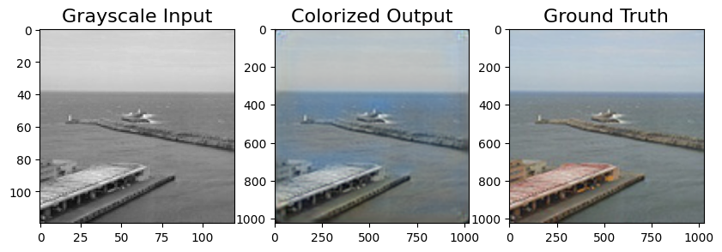

Slide 12

Thank you

